Slide 1
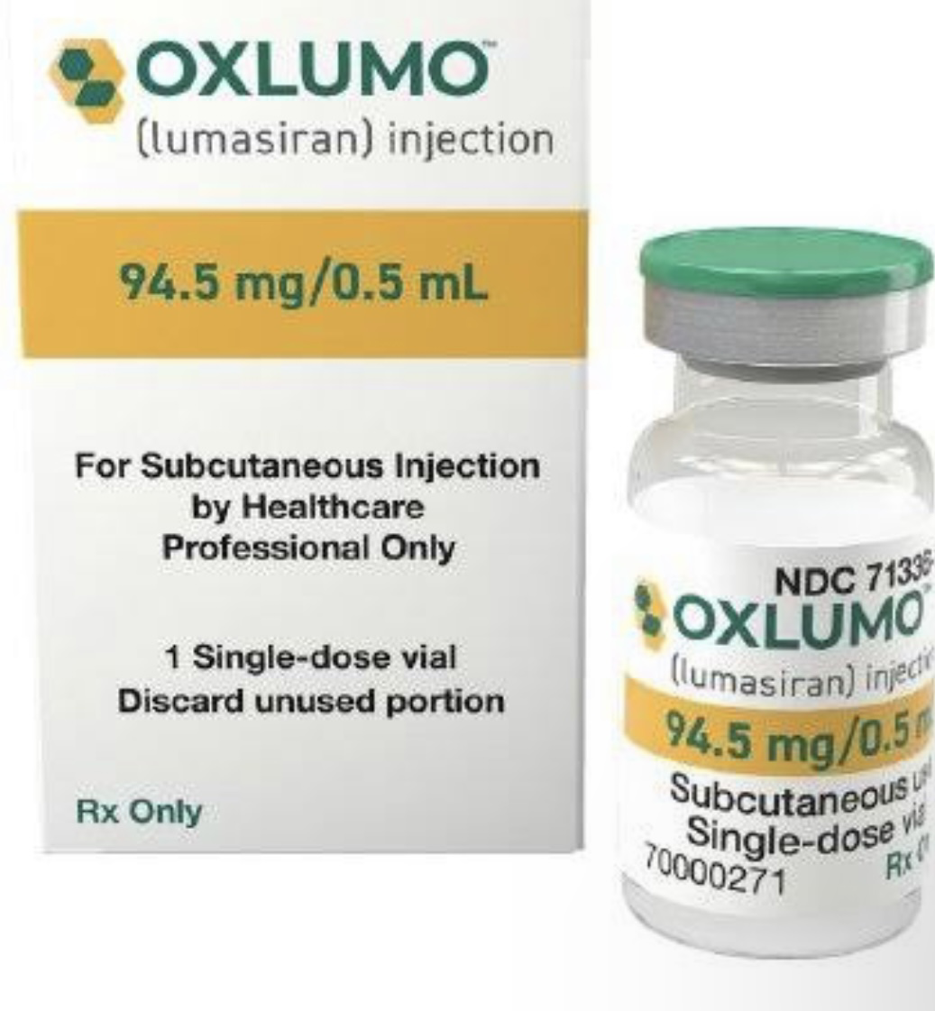
OXLUMO (LUMASIRAN)

Slide 2
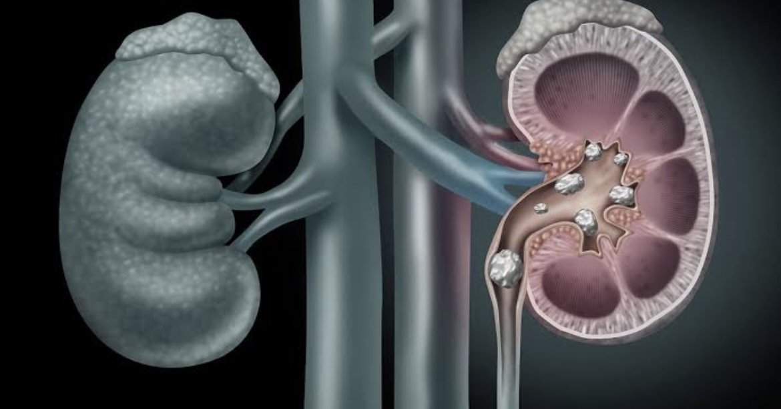
What is the drug for?
OXLUMO is a drug used to lower the level of urine oxalate in children and adults with primary hyperoxaluria type 1 (PH1).PH1 is a rare, inherited disorder in which the liver makes too much oxalate. Excess oxalate can lead to kidney stones and kidney damage. Over time, oxalate can also build up in the body and damage other organs, including the heart, bones and eyes.

Slide 3
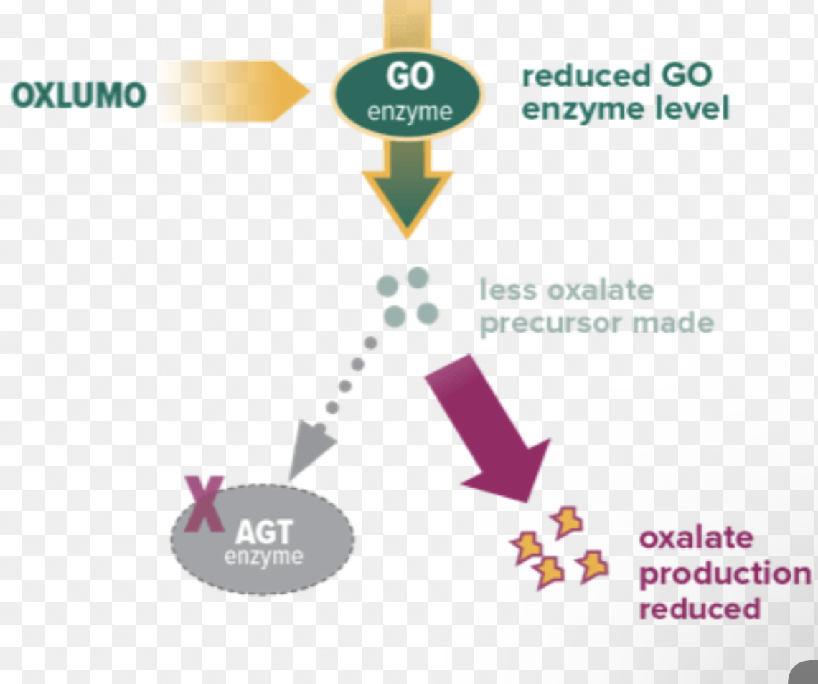
How is this drug used?
OXLUMO is an injection given under the skin (subcutaneously) once a month for the first three months. Some patients can then switch to an injection once every three months depending on their weight.

Slide 4
What are the benefits of this drug?
In one trial, patients treated with OXLUMO had a 65% decrease in urinary oxalate after 6 months of treatment compared with a 12% decrease in patients who received placebo. In a second trial, patients treated with OXLUMO had a decrease in urinary oxalate of 71%.

Slide 5
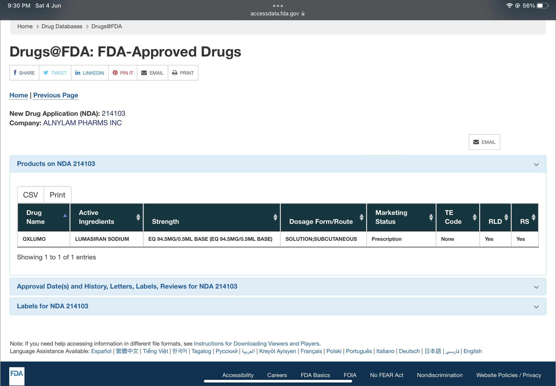
What are the possible side effects ?
Injection site reaction
Abdominal pain

Slide 6
Primary hyperoxaluria type 1 (PH1)
Primary hyperoxaluria type 1 (PH1) is a rare genetic disease caused by hepatic overproduction of oxalate, ultimately responsible for kidney stones, kidney failure and systemic oxalosis. Lumasiran, is a liver-directed RNA interference therapeutic agent. It has been shown to reduce hepatic oxalate production by targeting glycolate oxidase, and to dramatically reduce oxalate excretion.
Case Report: We present the case of a teenager patient affected by PH1, who entered in the lumasiran compassionate use program. The patient had a rapid and sustained decrease in urinary oxalate/creatinine ratio, with a mean reduction after lumasiran administration of about 70%. During the 18 months long follow-up, urinary oxalate remained low, reaching nearly normal values. Plasma oxalate also decreased dramatically. Normal levels were reached immediately after the first dose and remained consistently low thereafter. During the same follow-up period, eGFR remained stable at about 60 ml/min/1.73 m2, but no new kidney stones were observed. Existing kidney stones did not increase in size. The patient did not suffer renal colic events and did not require further urological interventions.

Slide 7
Conclusion
In our severely affected PH1 patient, lumasiran proved to be very effective in rapidly and consistently reducing plasma oxalate and urinary excretion to normal and near-normal levels, respectively. In the 18 months long follow-up post-lumasiran, the eGFR remained stable and the patient showed clinical improvements. As far as we know, this report covers the longest observation period after initiation of this novel RNAi therapy.

